Slide 1
Statistical methods
Jouko Miettunen, Professor of Clinical Epidemiology
Center for Life Course Health Research
University of Oulu

Slide 2
Contents
Comparing groups
Test assumptions
Multiple testing
Power and attrition
References

Slide 3
Comparing Two Groups

Slide 4
Categorical variable
Crosstabs, percentages
Chi-square (χ²) test
Continuous variables
Mean, Student’s t-test
Median, Mann-Whitney’s U-test

Slide 5
Research Question
Comparing two different groups
  Gender, treatment, ill/healthy, risk factor: no/yes, ...
  group i = (imaginary) population, consisting of all research units (e.g. individuals) with treatment i (i = 1 or 2)
Testing Null Hypothesis H₀:
  There is similar distribution in the variable of interest between the two groups (i.e. no difference)

Slide 6
Selection of the method (2 groups)
NO, qualitative
NO, because of skewness
Can we use mean?
YES
Crosstabs
- percentages
- χ² test
Means
- Student’s t-test for two independent samples
Medians
- non-parametric test: Mann-Whitney’s U test

Slide 7
Catogorical or Continuous Variable?
Phenomenon are often continuous, although studied as categorical
Categorization
  Looses information
  Easier to present findings
Methods of analysis differ

Slide 8
Categorical variables

Slide 9
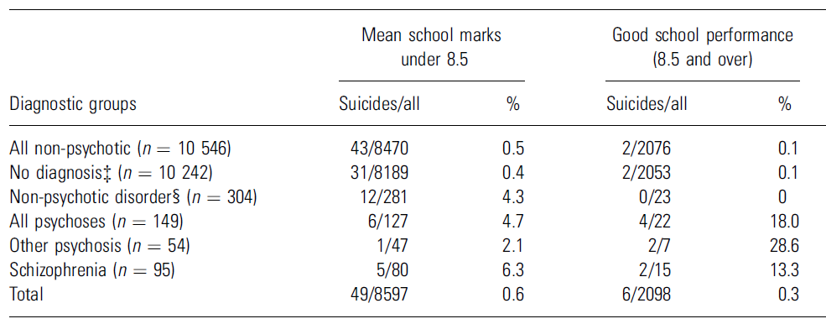
Comparing Relative Proportions
Example: School success and its association with suicide in psychotic and non-psychotic individuals in the Northern Finland 1966 Birth Cohort
Alaräisänen et al. Good school performance is a risk factor of suicide in psychoses: a 35-year follow up of the Northern Finland 1966 Birth Cohort. Acta Psychiatr Scand 2006; 114: 357-62.

Slide 10
The test is χ² -test
As a Crosstab
SPSS: Analyze > Descriptive statistics > crosstabs (statistics -> Chi-square)

Slide 11
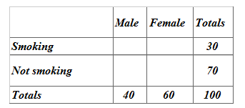
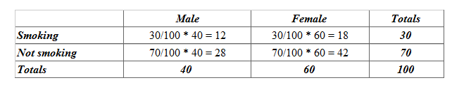

Chi-square test compares observed values to expected values
Expected values can be calculated using marginal values
30%
70%
30%
70%
30%
70%

Slide 12
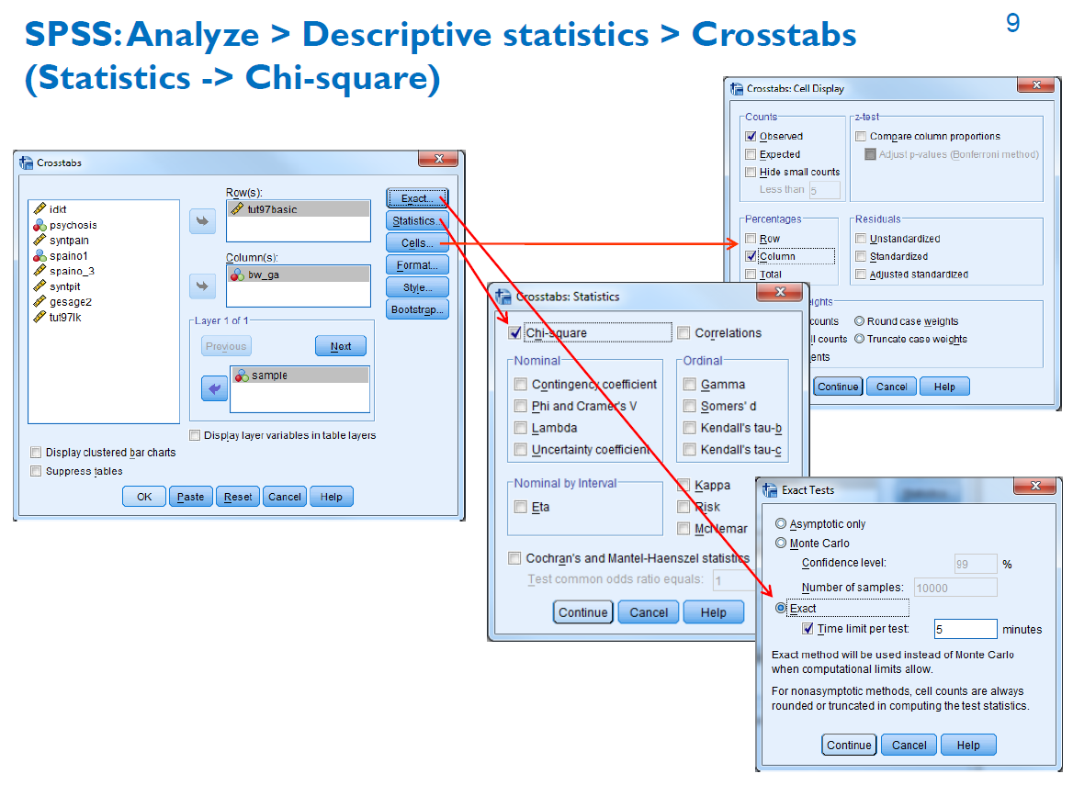

Slide 13
Example
Northern Finland Birth Cohort 1966
Association between maternal smoking during pregnancy and birth weight

Slide 14
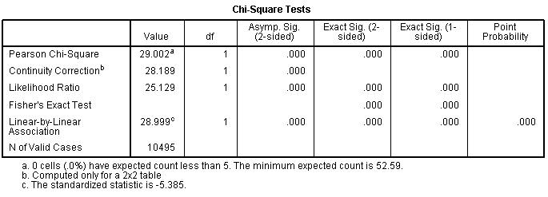
χ² –test: birth weight as a dichotomized variable

Slide 15
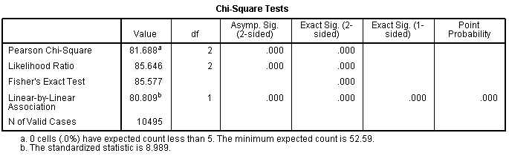
χ² –test: birth weight as a trichotomized variable

Slide 16
Mean or Median ?
Mean is suitable if the variable is approximately normally distributed
If the distribution is skew or there are several extreme values (outliers), median is more suitable in describing the distribution of the variable

Slide 17
Estimating Normality
If the mean and median differ largely, the distribution is not normal.
Kurtosis (huipukkuus) and skewness (vinous) describe normality
Different statistical test for normality, however visual estimation is important (histograms etc.)

Slide 18
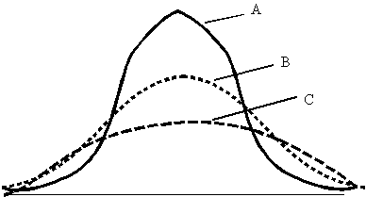
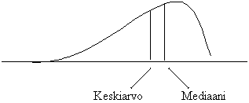
Different Types of Distributions
mean
median
B normally distributed
A positively kurtotic
C negatively kurtotitc
observations are more on the right (negatively skew distribution or skew to the left)

Slide 19
Symmetric Quantitative Outcome
Compare means between groups
Statistical significance
  Two groups: Student’s t-test for independent samples
  SPSS: Analyze > Compare Means > Independent-Samples T Test

Slide 20
t-test hypotheses
H₀: Mean values (expected values) of the studied attribute are equal in groups 1 and 2.
H₁: Mean values of the studied attribute differ between groups 1 and 2.

Slide 21
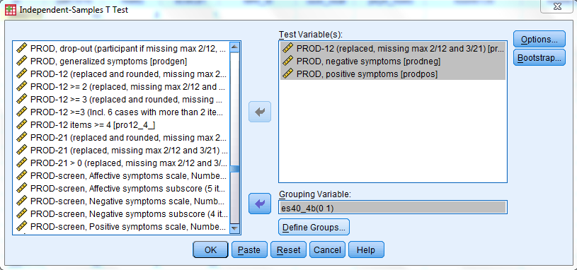
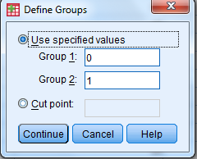
SPSS: Analyze > Compare Means > Independent-Samples T-Test

Slide 22
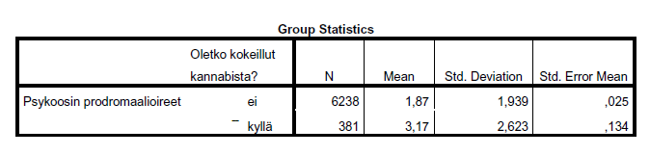
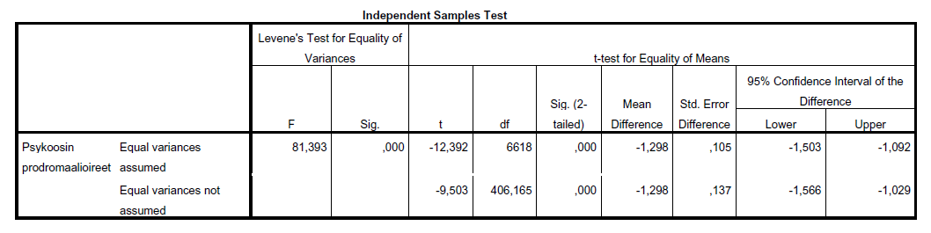
SPSS -output
Have you tried cannabis?
Prodromal symptoms
no
yes
Prodromal symptoms
Different variances (formula B)

Slide 23
Non-parametric methods
Are used when mean is not the proper statistic
  skew distribution
  extreme values (outliers)
No assumptions regarding probability distribution
  non-parametric = distribution-free, no parameters (e.g. mean or variance) defined for the distribution

Slide 24
Mann-Whitney’s U-test
The distribution of a variable in two groups is studied
It is asumed that the variable is at least in ordinal scale
The test is exact if the attribute is quantitative
The test is based on ranks of the observations in the pooled sample

Slide 25
Skew quantitative outcome
Report medians
  SPSS: Analyze > Descriptive Statistics > Explore
Statistical test
  Two groups: Mann-Whitney’s U-test
  SPSS: Analyze > Nonparametric Tests >
  Legacy dialogs > Two Independent Samples

Slide 26
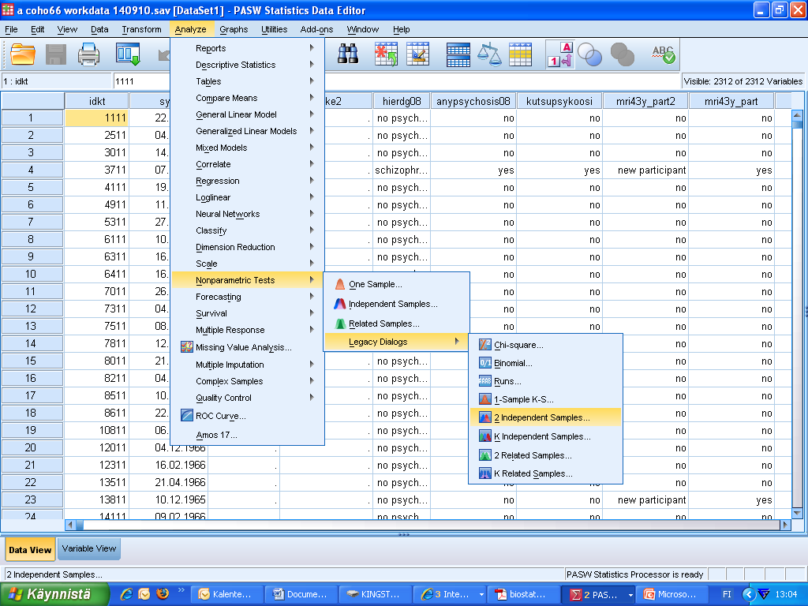

Slide 27
Mann-Whitney’s test example
rank | ALLERGY | NO ALLERGY | rank
7 | 31,0 | 4,7 | 1
11 | 39,6 | 5,2 | 2
16 | 64,7 | 6,6 | 3
17 | 65,9 | 18,9 | 4
18 | 67,6 | 27,3 | 5
19 | 100,0 | 29,1 | 6
20 | 102,4 | 32,4 | 8
21 | 1112,0 | 34,3 | 9
22 | 1651,0 | 35,4 | 10
 |  | 41,7 | 12
 |  | 45,5 | 13
 |  | 48,0 | 14
 |  | 48,1 | 15
Histamine concentration
Sample include 22 smokers
  9 with allergy
  13 without allergy

Slide 28
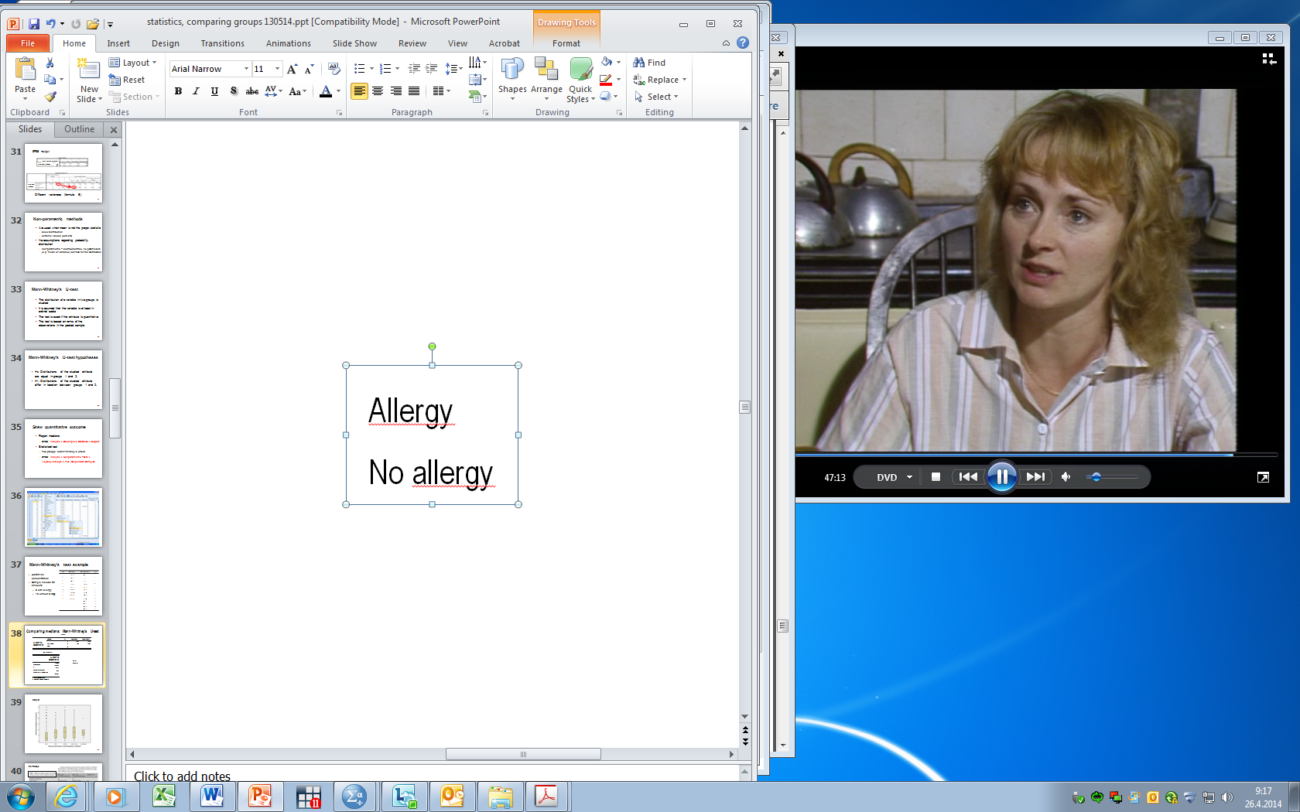
Comparing medians: Mann-Whitney’s U-test
Group
Histamine concentration
Histamine concentration
Group

Slide 29
Comparing Several Groups

Slide 30
TYPES OF OUTCOME VARIABLE
Type of outcome determines type of analysis
  Categorized variable
    Treatment, marital status, etc.
  Continuous variable
    Length, blood pressure, etc.
    Number of symptoms
    Number of treatment days

Slide 31
Selection of the method (2+ groups)
NO,qualitative
NO, because of skewness
Can we use mean?
YES
Crosstabs
- percentages
- χ² test
Means
- Analysis of variance
Medians
- non-parametric test: Kruskal-Wallis test

Slide 32
OUTCOME IS CATEGORICAL
Crosstab with the group variables
  SPSS command:
  Analyze- Descriptive Statistics - Crosstabs …
  Percentages
Statistical significance
  χ² -testi (Chi square)
  Fisher’s exact text (from Exact –button)

Slide 33
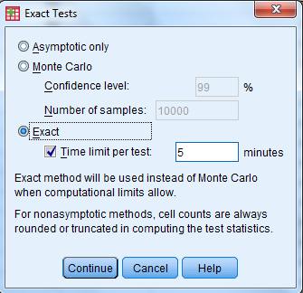
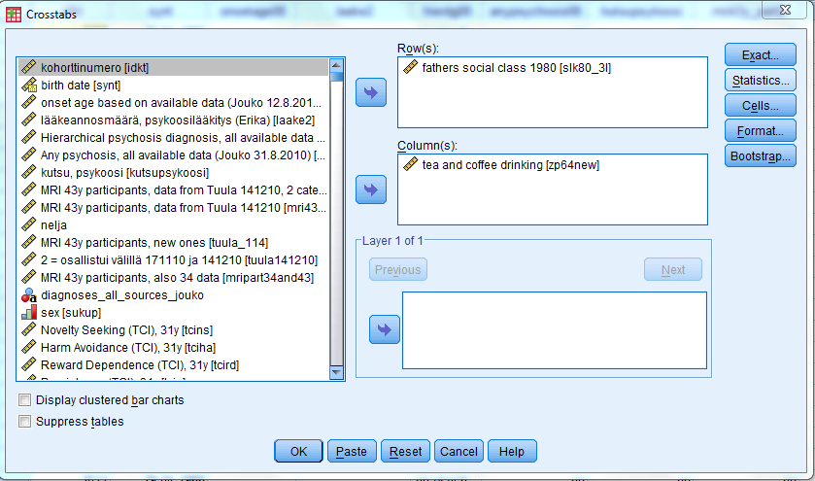
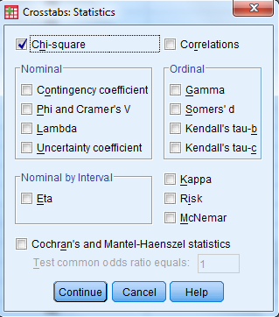
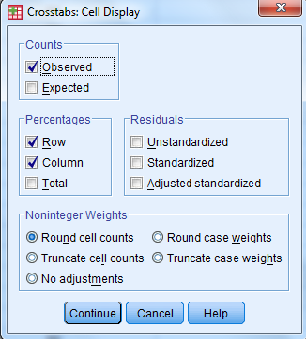
Analyze > Descriptive Statistics > Crosstabs

Slide 34
Symmetric Quantitative Outcome
Compare means
Statistical significance testing
  Two groups: t-test
  More than two groups: one-way analysis of variance (ANOVA)
  SPSS -komento: Analyze - Compare Means - One-Way Anova

Slide 35
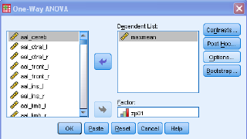
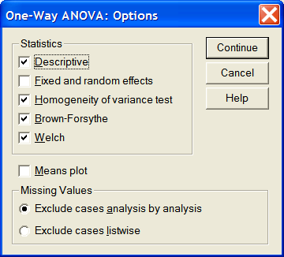
SPSS: One-way ANOVA
Analyze - Compare Means - One-Way Anova

Slide 36
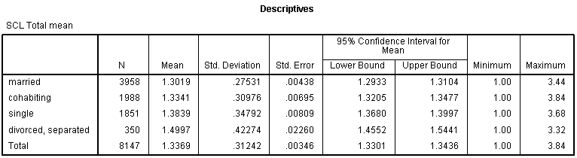
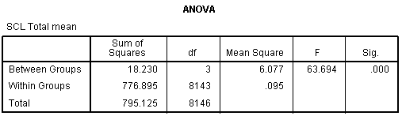
SPSS output
F test

Slide 37
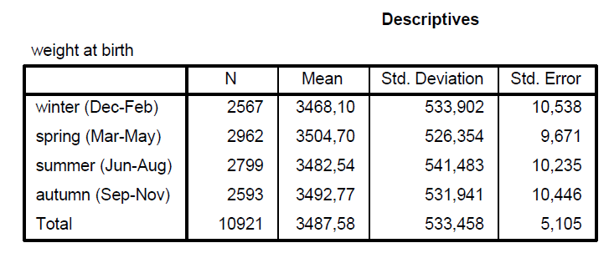
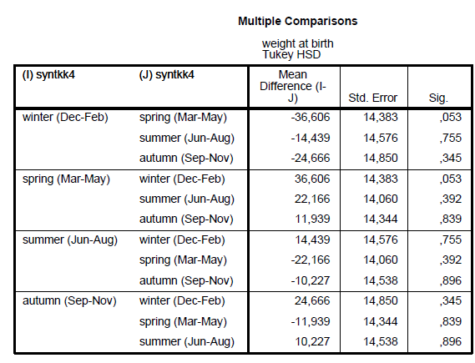
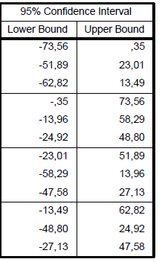
Example: Northern Finland Birth Cohort 1966

Slide 38
Example: depressive symptoms among medical students
P values for multiple comparisons
ANOVA p value
Baldassin et al. 2008

Slide 39
SKEW QUANTITATIVE OUTCOME
Report medians in different groups
  SPSS: Analyze - Decriptive Statistics - Explore
Statistical significance testing
  Two groups: Mann-Whitney’s U test
  More than two groups: Kruskal-Wallis test
  SPSS: Analyze - Nonparametric Tests – (Legacy Dialogs) - K Independent Samples

Slide 40
KRUSKAL-WALLIS TEST HYPOTHESES
H₀: Distributions of the studied attribute are equal in different groups
H₁: Distributions of the studied attribute differ in location between different groups
  The median value differs between groups
  At least one group differ from others

Slide 41
COMPARISON OF INDEPENDENT GROUPS

Slide 42
REPEATED MEASURES
Measures are not independent:
repeated measures t-test
repeated measures ANOVA

Slide 43
Comparing two continuous variables
Correlation coefficients
  Pearson vs. Spearman
Linear regression

Slide 44
Multivariate methods
ANOVA, MANOVA
  One or several continuous outcome (dependent) variables
Repeated measurements ANOVA
  Same measurements are made several times on each subject
ANOVA, MANOVA and rANOVA
  Only categorical predictors
ANCOVA, MANCOVA, rANCOVA
  Also continuous predictors
Different regression analyses
  Linear, logistic, etc.

Slide 45
Test assumptions
Normality
  Visual check is important
  Mean vs. Median
  Assumption in regression analysis
  Transformations
    can complicate interpretation
Osborne and Waters 2002

Slide 46
Test assumptions
Independence of observations
  Unusual event if well designed study
  In large studies usually not a problem
Reliability of measurements
  Poor reliability reduces power
Osborne and Waters 2002

Slide 47
Test assumptions
Homoscedasticity
  i.e. variance should be the same across all levels of the variable
  assumed regression analysis
  high heteroscedasticity decreases power
Osborne and Waters 2002

Slide 48
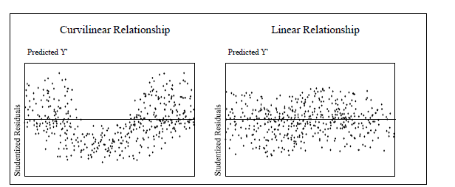
Test assumptions
Non-linear associations reduce power in standard multiple regression
Osborne and Waters 2002

Slide 49

Multiple testing

Slide 50
Multiple testing
Setting hypotheses is important!
Data fishing
Corrections for multiple testings
  e.g. Bonferroni correction
    Simple, but conservative method
Bootstrapping methods
Post-Hoc testing of ANOVAs

Slide 51
Interpretation
Statistical significance vs. effect?
The difference between ‘significant’ and ‘not significant’ is not itself statistically significant
”Absence of evidence is not evidence of absence”

Slide 52

Power

Slide 53
Power analyses
Well done sample size (power) analyses should be part of all study plans
Too much research done with small samples → ethical problem!

Slide 54
Power analyses
Samples sizes in clinical trials are usually small, e.g.
  Rheumatoid arthritis: median sample size 54 patients (196 trials)
Sample size is usually not based on anything!
Post hoc power calculations are unnecessary, confidence intervals tell about power
Moher et al. CONSORT statement 2010

Slide 55
Power analyses
Need to know
  Number of persons
  Prevalence of the primary outcome (expected number of events)
Assumptions to be made
  Effect size
  Significance level (α)
  Statistical power (1-β)

Slide 56
Alpha i.e. significance level (e.g. 0.05 or 5%)
  Probabibility that difference is found but it is not real (false positive finding)
Beta i.e. power (e.g. 0.8 or 80%)
  Probability that the found difference is real
Interim analysis is a a priori planned analyses done in an ongoing trial
  Reasons for this ethical or economical
  α – error increases
  Power can be inadequate?
Suresh KP & Chandrashekara S. J Hum Reprod Sci 2012; 5: 7–13.

Slide 57
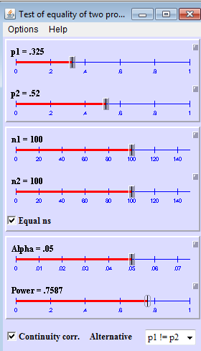
Different situations
  Difference in means
  Difference in proportions
  Multiple variable analyses
Different software
  Web pages
  Specific software
    SPSS sample power, …
http://homepage.stat.uiowa.edu/~rlenth/Power/index.html

Slide 58

Attrition
Take into account attrition
Patients and doctors participate poorly to clinical trials.
Attrition (lost to follow up) may be biased based on outcome
If <80% included in the final analyses, the results should not be taken into account (EBM toolkit 2006).

Slide 59
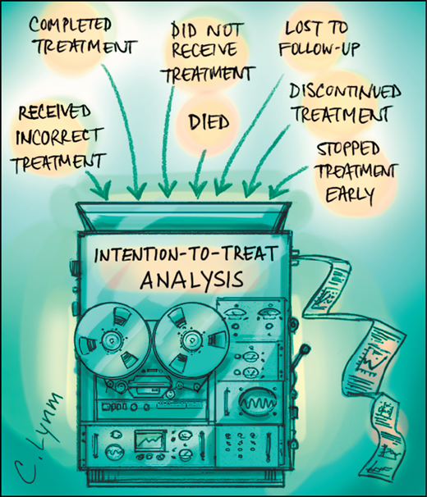
Intention-to-treat
Intention-to-treat analysis, i.e. the data is analyzed based on the original randomization
The effect of randomization remains!

Slide 60
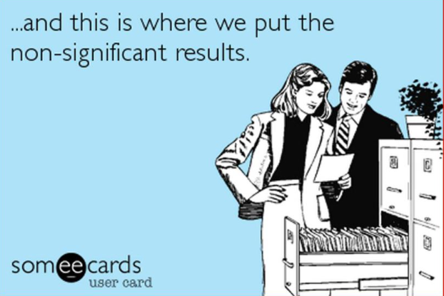
Non-significant results
http://mchankins.wordpress.com/2013/04/21/still-not-significant-2/

Slide 61
Examples of poor reporting of non-significant results
a clear, strong trend (p=0.09)
an encouraging trend (p<0.1)
an important trend (p=0.066)
approached conventional levels of significance (p<0.10)
below (but verging on) the statistical significant level (p>0.05)
difference was apparent (p=0.07)
essentially significant (p=0.10)
failed to reach significance on this occasion (p=0.09)
flirting with conventional levels of significance (p>0.1)
leaning towards significance (p=0.15)
narrowly escaped significance (p=0.08)
not conventionally significant (p=0.089), but..
not significant in the narrow sense of the word (p=0.29)
on the very fringes of signiﬁcance (p=0.099)
http://mchankins.wordpress.com/2013/04/21/still-not-significant-2/

Slide 62
Literature
Altman DG. Statistics and ethics in medical research. Misuse of statistics is unethical. Br Med J 1980; 281: 1182–4.
DeMets DL. Statistics and ethics in medical research. Science and Engineering Ethics 1999; 5:97-117.
Easterbrook PJ, et al. Publication bias in clinical research. Lancet 1991; 337:867–72.
Gardenier J & Resnik D. The misuse of statistics: concepts, tools, and a research agenda. Accountability in Research: Policies and Quality Assurance 2002; 9:65-74.

Slide 63
Literature
Hutton JL. The ethics of randomised controlled trials: a matter of statistical belief? Health Care Anal 1996; 4:95-102
Lang T. Twenty statistical errors even you can find in biomedical research articles. Croatian Med J 2004; 45:361-70.
Ioannidis JPA. Why most published research findings are false. PLOS Medicine 2005;2:e124.
Moher D, et al. CONSORT 2010 explanation and elaboration: updated guidelines for reporting parallel group randomised trials. BMJ 2010; 340:c869.

Slide 64
Literature
Osborne JW & Waters E. Four assumptions of multiple regression that researchers should always test. Practical Assessment, Research, and Evaluation 2002: 8 (available online).
Palmer CR. Ethics and statistical methodology in clinical trials. J Med Ethics 1993; 19:219-22.
Suresh KP & Chandrashekara S. Sample size estimation and power analysis for clinical research studies. J Hum Reprod Sci 2012; 5: 7–13.
jouko.miettunen@oulu.fi

